Slide 1
OSINT Company Investigation Report
Target Company: IBM
Prepared By: Medha V P

Slide 2

Objective
To investigate IBM using only publicly available information and understand its digital presence through OSINT techniques.

Slide 3
Company Overview
Full Name: International Business Machines Corporation
Founded: 1911
Headquarters: Armonk, New York, USA
CEO: Arvind Krishna
Industry: Information Technology
Employees: 280,000+ worldwide
Global Presence: Operates in more than 170 countries
Main Products & Services: IBM Cloud, Watson AI, Cybersecurity Solutions, Consulting Services, Quantum Computing

Slide 4

Official Website Investigation

Slide 5

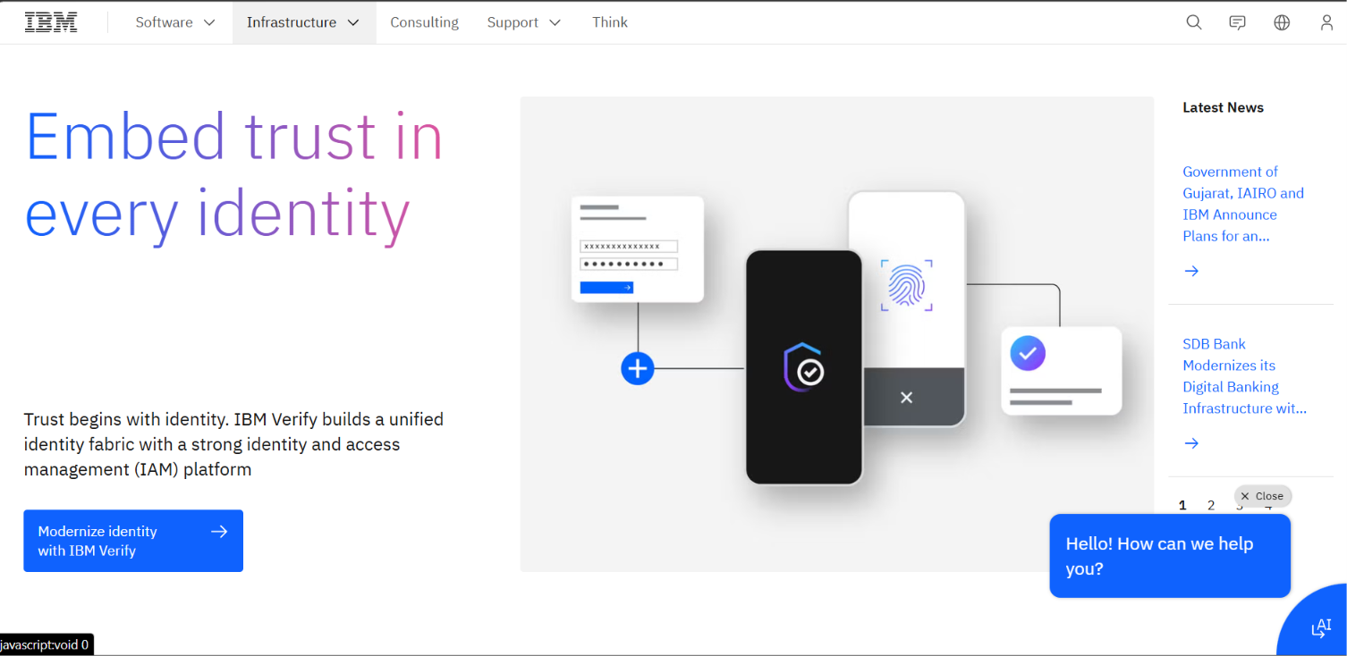
Power of communication

Slide 6
Official Website
Website: https://www.ibm.com
Observations
HTTPS enabled
Secure SSL certificate
Professional and user-friendly interface
Easy navigation
Main Sections: Products, Consulting, Research, Careers, Support

Slide 7
Domain & DNS Analysis

Slide 8
Domain Information
Item | Details
Domain | ibm.com
Registrar | CSC Corporate Domains, Inc.
Created | March 19, 1986
HTTPS | Enabled

Slide 9
DNS Analysis
DNS Records
A Record
MX Record
NS Record
Tools Used
WHOIS
DNSChecker
MXToolbox
nslookup

Slide 10

Technology Stack Analysis

Slide 11
Website Technologies
IBM uses modern web technologies to provide a secure and reliable user experience.
Technologies Identified
HTTPS
SSL/TLS Encryption
Content Delivery Network (CDN)
JavaScript
Responsive Web Design
Analytics & Cookies

Slide 12
Digital Footprint

Slide 13
IBM's Online Presence
IBM maintains an active presence across multiple platforms.
Official Platforms: LinkedIn, GitHub, YouTube, X (Twitter), Facebook, Instagram
Purpose:
Share company updates
Publish research
Recruit talent
Engage with customers
Promote products and services

Slide 14
Google Dork Investigation

Slide 15
Google Dorks Used
Google Dork | Purpose
site:ibm.com filetype:pdf | Find PDF documents
site:ibm.com annual report | Annual reports
site:ibm.com filetype:ppt | Presentations
site:ibm.com AI | AI-related pages
site:ibm.com sustainability report | ESG reports

Slide 16
Google Dorks Used
Document | File Type | Purpose
Annual Report | PDF | Financial Information
Sustainability Report | PDF | ESG Activities
AI White Paper | PDF | AI Research
Product Brochure | PDF | Product Details
Observation: IBM provides extensive public documentation for customers, investors, and researchers.

Slide 17
Wayback Machine Analysis
Historical Website Analysis
The Wayback Machine was used to compare older versions of IBM's website with the current version.
Observations
Improved website design
Better navigation
Expanded cloud and AI content
Modern user interface
More customer-focused homepage

Slide 18
Recent News & Developments
Continued investment in Artificial Intelligence.
Expansion of IBM Cloud services.
Advances in Quantum Computing research.
New partnerships in enterprise AI solutions.
Focus on sustainable and responsible technology.

Slide 19
Investigation Summary
IBM has over 100 years of history.
Strong global digital presence.
Secure and professionally maintained website.
Extensive collection of public documents.
Active presence on major social media platforms.
Significant focus on AI, Cloud, and Cybersecurity.
Demonstrates strong cybersecurity and digital infrastructure

Slide 20
Conclusion
This investigation demonstrated how publicly available information can be collected and analyzed using OSINT techniques.
IBM has a strong digital presence, secure infrastructure, and extensive publicly available resources. This investigation highlights the importance of ethical intelligence gathering and responsible use of open-source information.

Slide 21
Thank you

